Slide 1
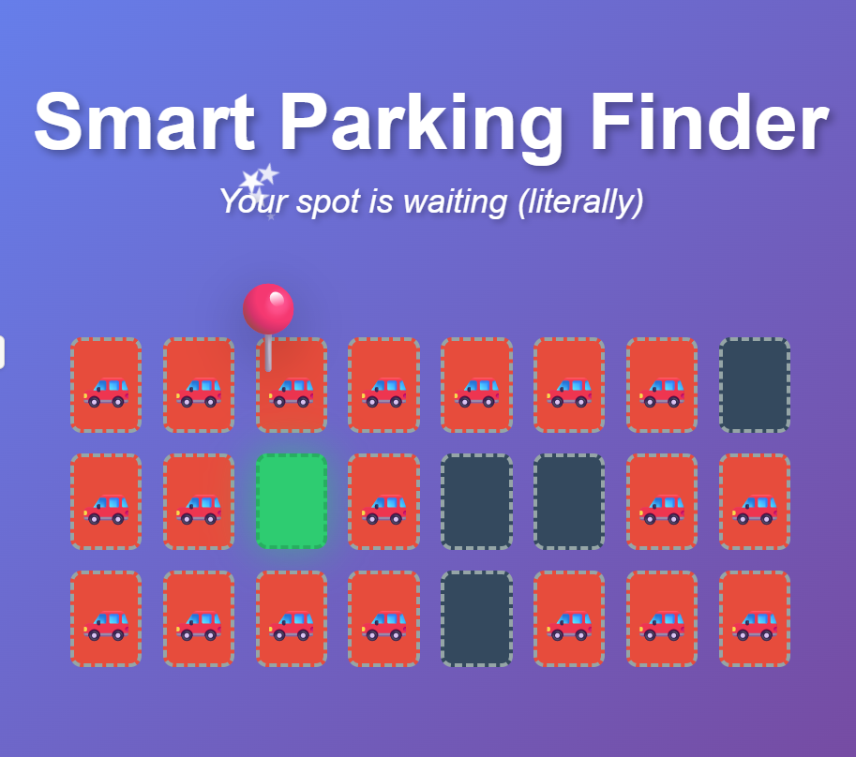
Product name: Smart Parking Finder

Slide 2
Problem → Solution
Searching for parking in busy areas is frustrating
Drivers waste valuable time circling for a spot
An AI-powered app that detects open spaces in real time
Users are instantly shown available spots near them

Slide 3
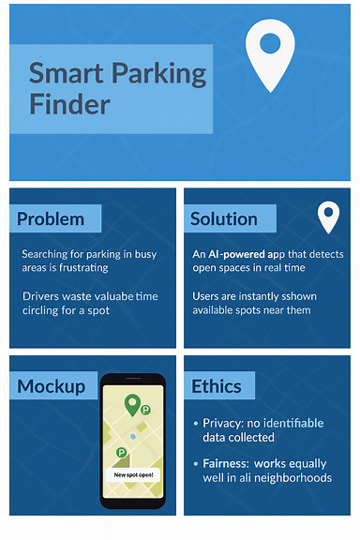
Mockup: Mobile app interface showing nearby open parking spots

Slide 4
Ethics
Content:
Privacy: No identifiable data collected
Fairness: Works equally well in all neighborhoods
Transparency: Explains how spots are found to users

